Slide 1
PART V
Transport Layer

Slide 2
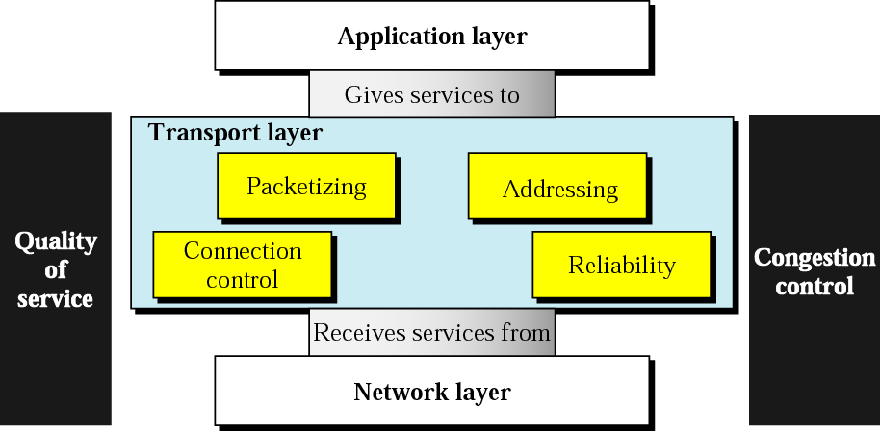
Position of transport layer

Slide 3
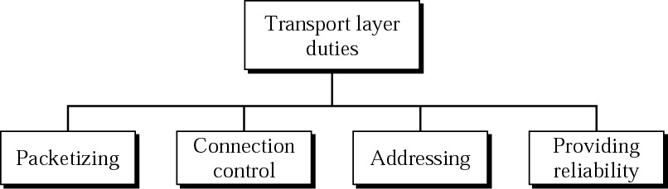
Transport layer duties

Slide 4
Chapters
Chapter 22 Process-to-Process Delivery
Chapter 23 Congestion Control and QoS

Slide 5
Chapter 22
Process-to-Process Delivery: UDP and TCP

Slide 6
22.1 Process-to-Process Delivery
Client-Server Paradigm
Addressing
Multiplexing and Demultiplexing
Connectionless/Connection-Oriented
Reliable/Unreliable

Slide 7
Note:
The transport layer is responsible for process-to-process delivery.

Slide 8
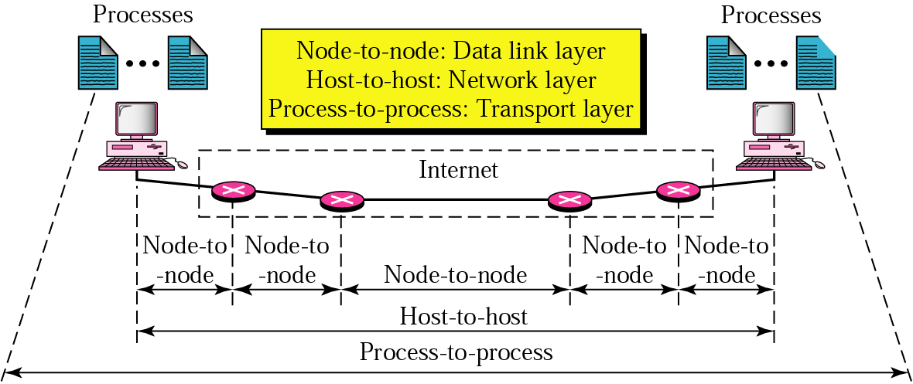
Figure 22.1 Types of data deliveries

Slide 9
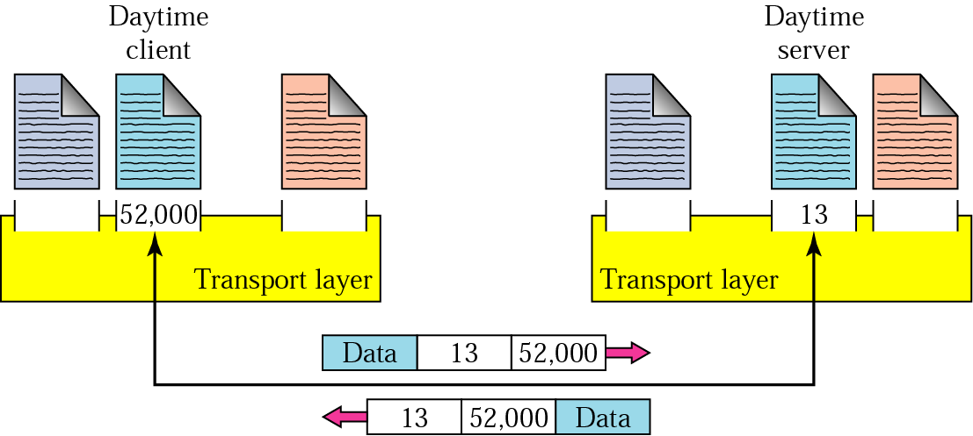
Figure 22.2 Port numbers

Slide 10
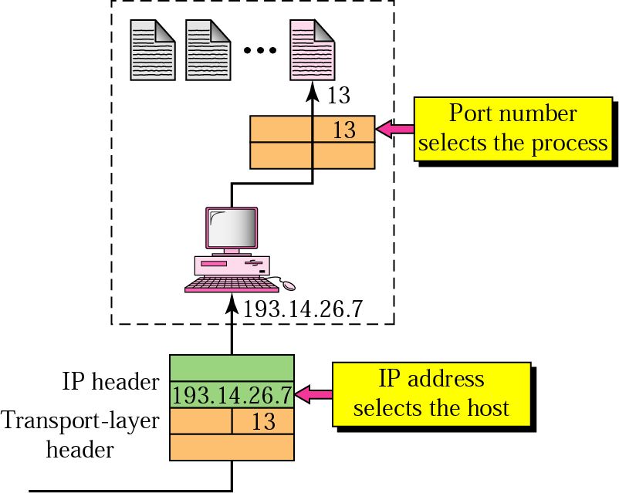
Figure 22.3 IP addresses versus port numbers

Slide 11
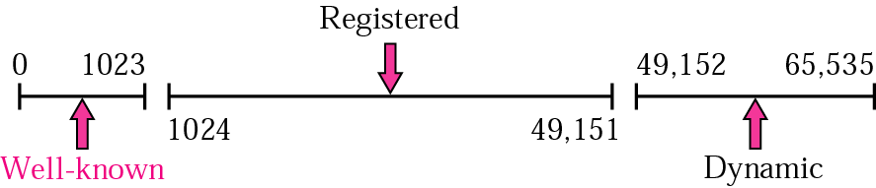
Figure 22.4 IANA ranges

Slide 12
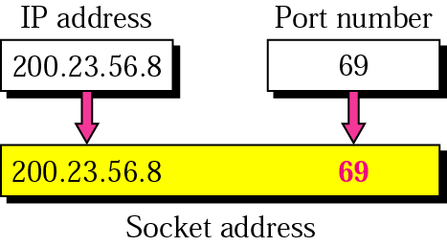
Figure 22.5 Socket address

Slide 13
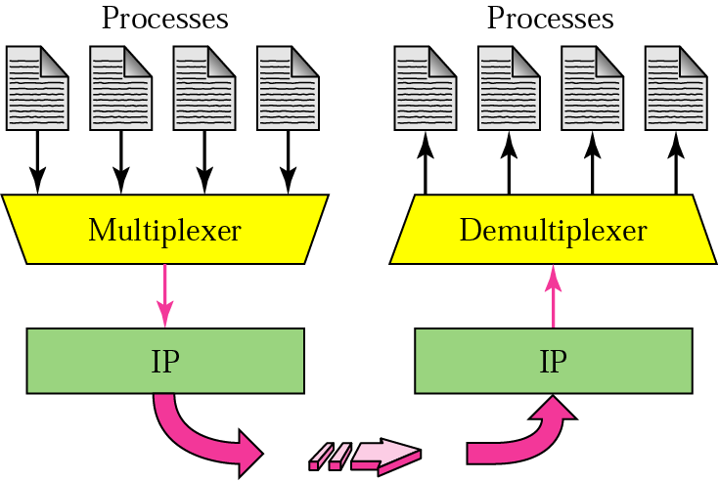
Figure 22.6 Multiplexing and demultiplexing

Slide 14
Connectionless vs. Connection-oriented service
A transport-layer protocol can either be connectionless or connection-oriented
Connectionless service
Packets are sent from one party to another without no need for connection establishment
Packets are not numbered
They may be delayed, lost or arrive out of order
No acknowledgement
E.g., UDP

Slide 15
Connection-oriented service
Data are transferred after a connection is first established
E.g., TCP

Slide 16
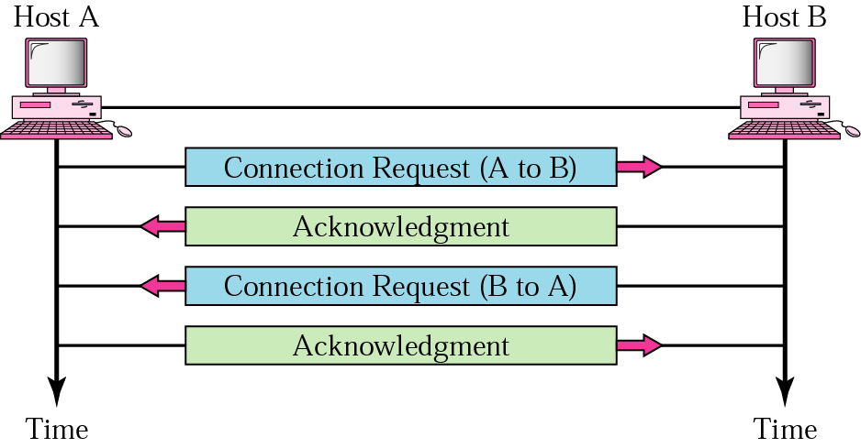
Figure 22.7 Connection establishment

Slide 17
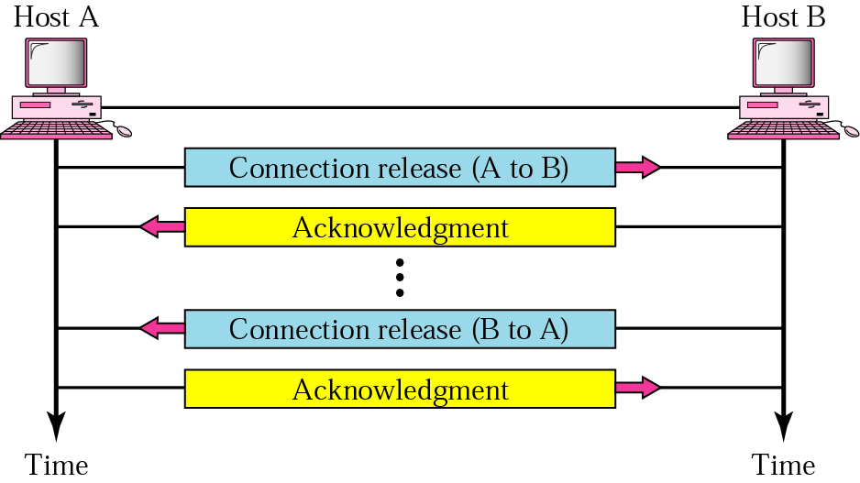
Figure 22.8 Connection termination

Slide 18
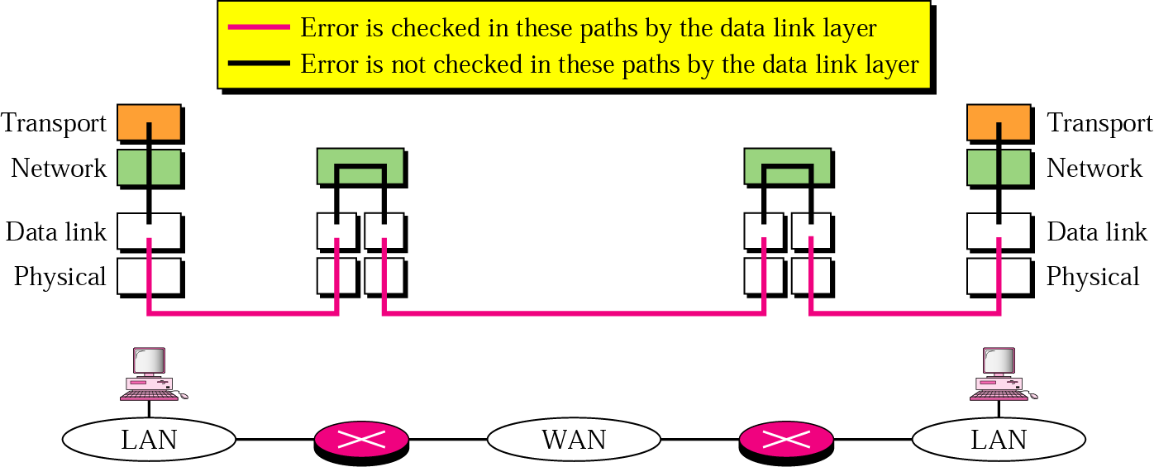
Figure 22.9 Error control

Slide 19
22.2 UDP
Port Numbers
User Datagram
Applications

Slide 20
Note:
UDP is a connectionless, unreliable protocol that has no flow and error control. It uses port numbers to multiplex data from the application layer.

Slide 21
Table 22.1 Well-known ports used by UDP
Port | Protocol | Description
7 | Echo | Echoes a received datagram back to the sender
9 | Discard | Discards any datagram that is received
11 | Users | Active users
13 | Daytime | Returns the date and the time
17 | Quote | Returns a quote of the day
19 | Chargen | Returns a string of characters
53 | Nameserver | Domain Name Service
67 | Bootps | Server port to download bootstrap information
68 | Bootpc | Client port to download bootstrap information
69 | TFTP | Trivial File Transfer Protocol
111 | RPC | Remote Procedure Call
123 | NTP | Network Time Protocol
161 | SNMP | Simple Network Management Protocol
162 | SNMP | Simple Network Management Protocol (trap)

Slide 22
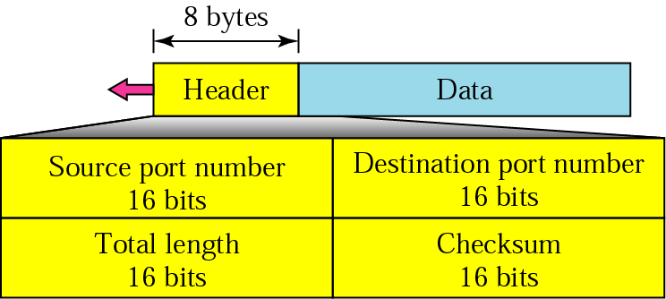
Figure 22.10 User datagram format

Slide 23
Note:
UDP is a convenient transport-layer protocol for applications that provide flow and error control. It is also used by multimedia applications.

Slide 24
LAN
A
B
C
/User
/DataB
/DataC
NFS by UDP
(optionally TCP)
왜 TCP가 default가 아닐까?
LAN 환경에서 패킷 오류는 거의 없기 때문
A
/User
/B/DataB
/C/DataC
B
/DataB
/A/User
/C/DataC
C
/DataC
/A/User
/B/DataB
Mount!

Slide 25
Multimedia 응용은 과거에는 거의 UDP 가정
최근에는 많은 경우 멀티미디어 응용에도 TCP 사용
왜?
1. 사용자가 고품질 재생을 원하기 때문
2. 네트워크 대역폭과 품질이 대폭 향상
(과거 수십 Kbps => 최근 수 Mbps)
클라이언트 버퍼링을 이용하면 패킷소실에 대한 재전송 시간이 있음
30초분량 버퍼링
30초내에 소실된 패킷 재전송하면 됨
만일 소실된 패킷이 도착하지 않으면?
“버퍼링 중＂ 메시지 출력하고 멈춤

Slide 26
22.3 TCP
Port Numbers
Services
Sequence Numbers
Segments
Connection
Transition Diagram
Flow and Error Control
Silly Window Syndrome

Slide 27
Table 22.2 Well-known ports used by TCP
Port | Protocol | Description
7 | Echo | Echoes a received datagram back to the sender
9 | Discard | Discards any datagram that is received
11 | Users | Active users
13 | Daytime | Returns the date and the time
17 | Quote | Returns a quote of the day
19 | Chargen | Returns a string of characters
20 | FTP, Data | File Transfer Protocol (data connection)
21 | FTP, Control | File Transfer Protocol (control connection)
23 | TELNET | Terminal Network
25 | SMTP | Simple Mail Transfer Protocol
53 | DNS | Domain Name Server
67 | BOOTP | Bootstrap Protocol
79 | Finger | Finger
80 | HTTP | Hypertext Transfer Protocol
111 | RPC | Remote Procedure Call

Slide 28
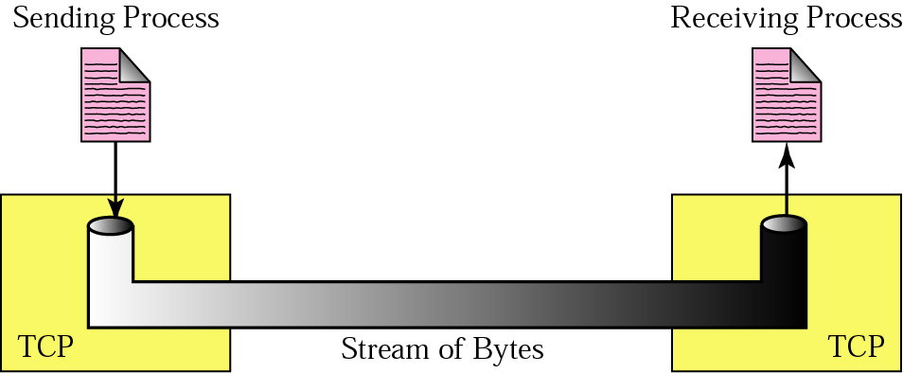
Figure 22.11 Stream delivery
In-order
Reliable transmission

Slide 29
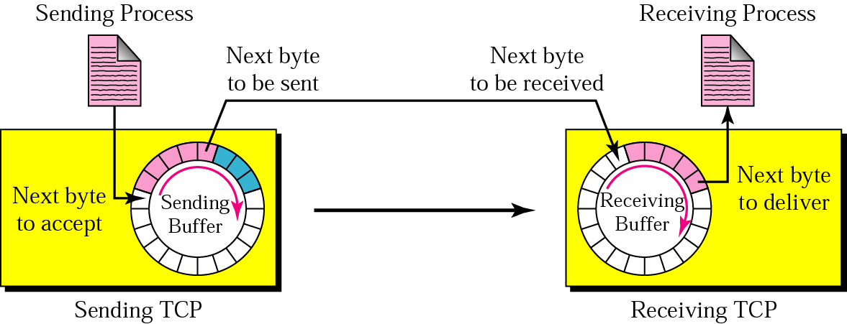
Figure 22.12 Sending and receiving buffers

Slide 30
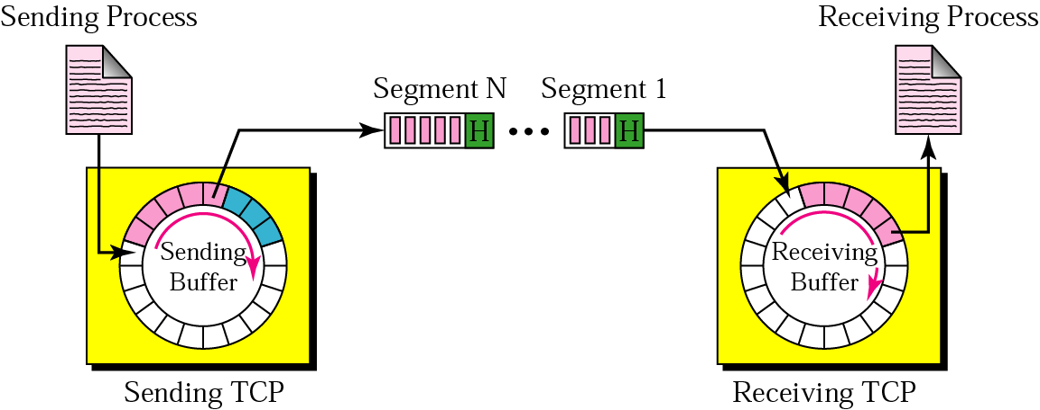
Figure 22.13 TCP segments

Slide 31
Example 1
Imagine a TCP connection is transferring a file of 6000 bytes. The first byte is numbered 10010. What are the sequence numbers for each segment if data are sent in five segments with the first four segments carrying 1000 bytes and the last segment carrying 2000 bytes?
Solution
The following shows the sequence number for each segment:
Segment 1 ==> sequence number: 10,010 (range: 10,010 to 11,009)
Segment 2 ==> sequence number: 11,010 (range: 11,010 to 12,009)
Segment 3 ==> sequence number: 12,010 (range: 12,010 to 13,009)
Segment 4 ==> sequence number: 13,010 (range: 13,010 to 14,009)
Segment 5 ==> sequence number: 14,010 (range: 14,010 to 16,009)

Slide 32
Note:
The bytes of data being transferred in each connection are numbered by TCP. The numbering starts with a randomly generated number.

Slide 33
Note:
The value of the sequence number field in a segment defines the number of the first data byte contained in that segment.

Slide 34
Note:
The value of the acknowledgment field in a segment defines the number of the next byte a party expects to receive. The acknowledgment number is cumulative.

Slide 35
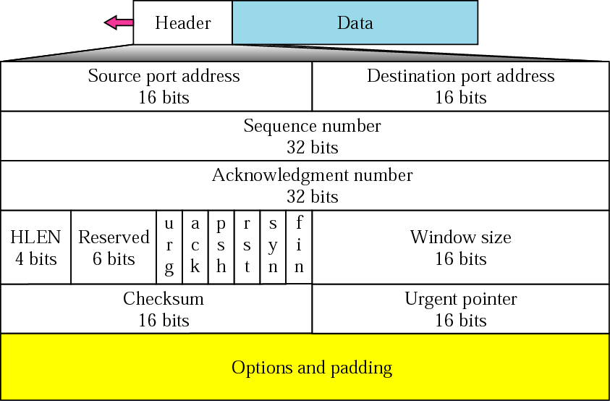
Figure 22.14 TCP segment format

Slide 36
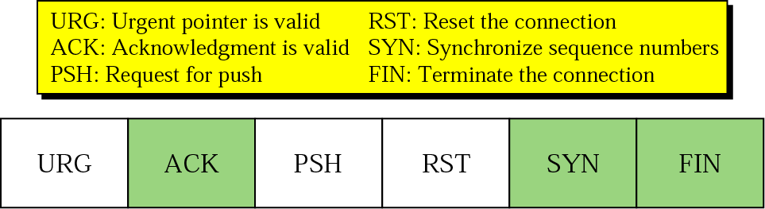
Figure 22.15 Control field

Slide 37
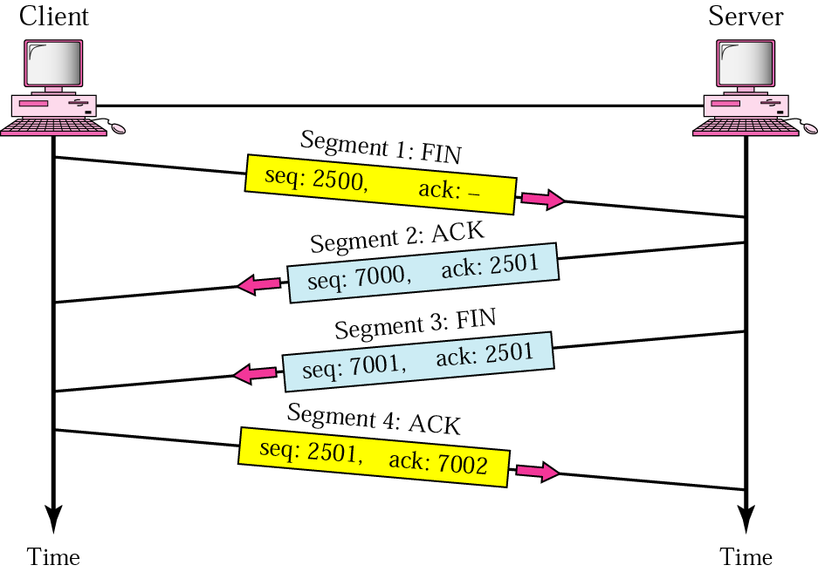
Figure 22.17 Four-step connection termination

Slide 38
TCP seq. #’s and ACKs
Seq. #’s:
byte stream “number” of first byte in segment’s data
ACKs:
seq # of next byte expected from other side
cumulative ACK
Q: how receiver handles out-of-order segments
A: TCP spec doesn’t say, - up to implementor
Host A
Host B
User
types
‘C’
Seq=42, ACK=79, data = ‘C’
host ACKs
receipt of
‘C’, echoes
back ‘C’
Seq=79, ACK=43, data = ‘C’
host ACKs
receipt
of echoed
‘C’
Seq=43, ACK=80
time
simple telnet scenario

Slide 39
Table 22.4 States for TCP
State | Description
CLOSED | There is no connection.
LISTEN | The server is waiting for calls from the client.
SYN-SENT | A connection request is sent; waiting for acknowledgment.
SYN-RCVD | A connection request is received.
ESTABLISHED | Connection is established.
FIN-WAIT-1 | The application has requested the closing of the connection.
FIN-WAIT-2 | The other side has accepted the closing of the connection.
TIME-WAIT | Waiting for retransmitted segments to die.
CLOSE-WAIT | The server is waiting for the application to close.
LAST-ACK | The server is waiting for the last acknowledgment.

Slide 40
Flow control
To prevent the buffer overflow at the receiver
how?
Sliding window protocol!

Slide 41
Note:
A sliding window is used to make transmission more efficient as well as to control the flow of data so that the destination does not become overwhelmed with data. TCP’s sliding windows are byte-oriented.

Slide 42
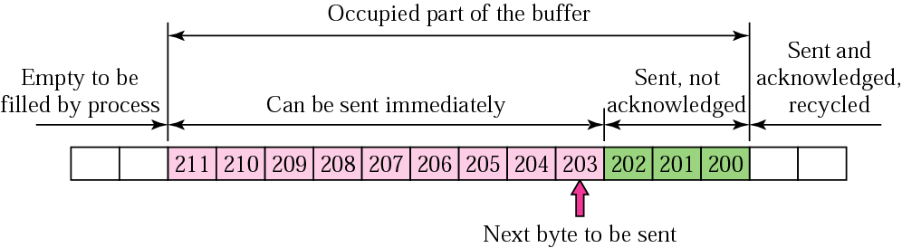
Figure 22.19 Sender buffer
If the receiver has a small buffer
and the sender transmits as fast as possible,
the receiver’s buffer can be overflowed

Slide 43
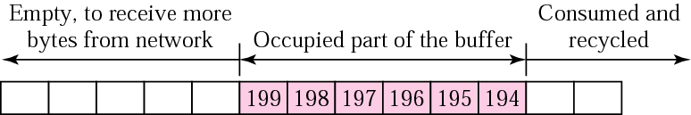
Figure 22.20 Receiver window
Circular buffer
implementation
Buffer size=10
Receiver’s window size=6

Slide 44
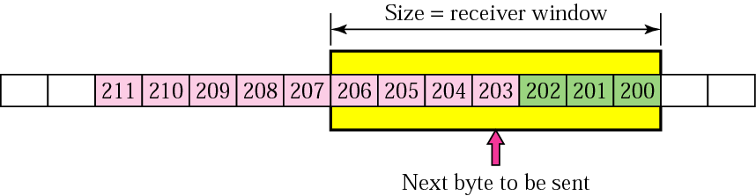
Figure 22.21 Sender buffer and sender window
Cannot be sent
at this time
Sender window size must be less than or equal to
the receiver’s window size

Slide 45
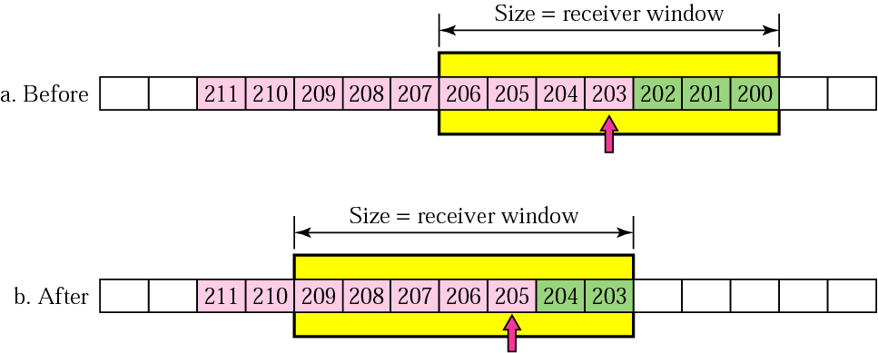
Figure 22.22 Sliding the sender window

Slide 46
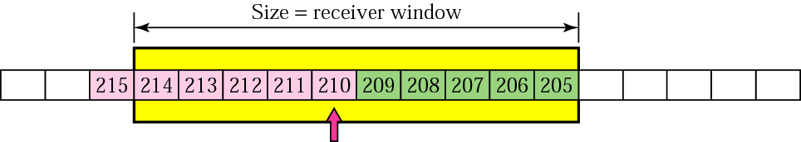
Figure 22.23 Expanding the sender window
If the receiving process consumes data faster than it receives,
the size of the receiver window expands.
Then, the sender’s window also expands.

Slide 47
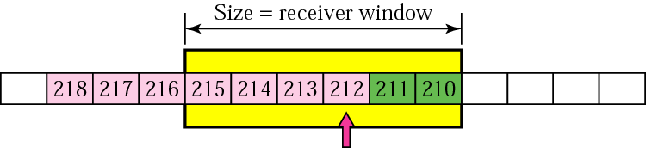
Figure 22.24 Shrinking the sender window

Slide 48
Note:
In TCP, the sender window size is totally controlled by the receiver window value (the number of empty locations in the receiver buffer). However, the actual window size can be smaller if there is congestion in the network.

Slide 49
Note:
Some points about TCP’s sliding windows:
The source does not have to send a full window’s worth of data.
The size of the window can be increased or decreased by the destination.
The destination can send an acknowledgment at any time.

Slide 50
Error control
TCP is a reliable transport-layer protocol
Error control in TCP
Detecting corrupted segments
checksum
Detecting lost segments
Sequence number
Detecting out-of-order segments
Sequence number
Detecting duplicated segments
Sequence number

Slide 51
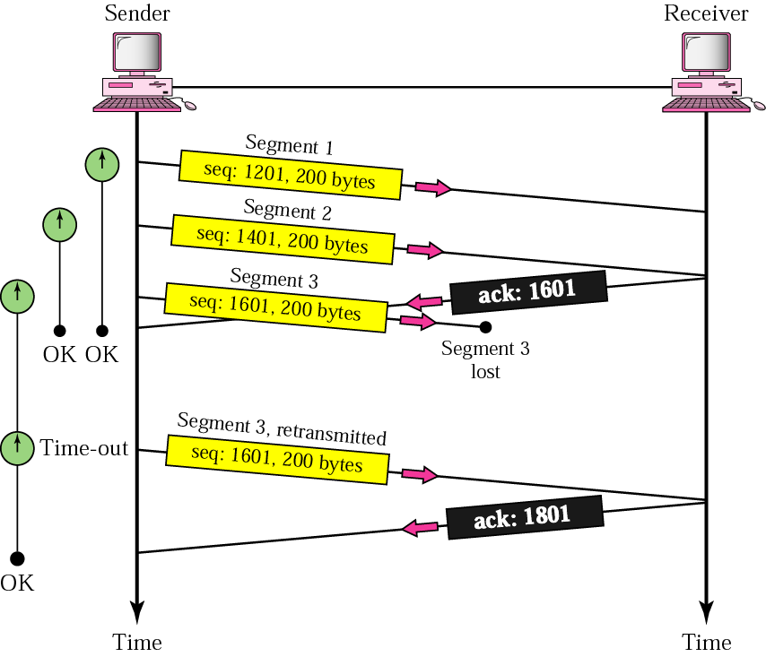
Figure 22.25 Lost segment

Slide 52
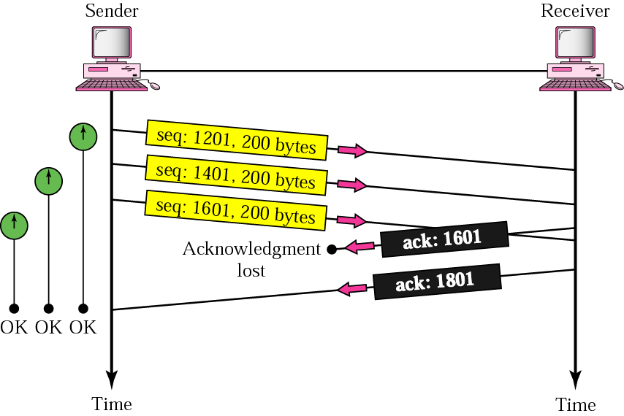
Figure 22.26 Lost acknowledgment

Slide 53
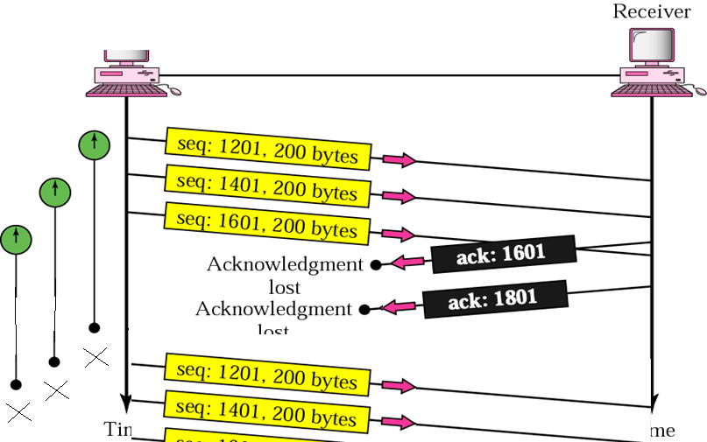
Lost acknowledgment (another case)

Slide 54
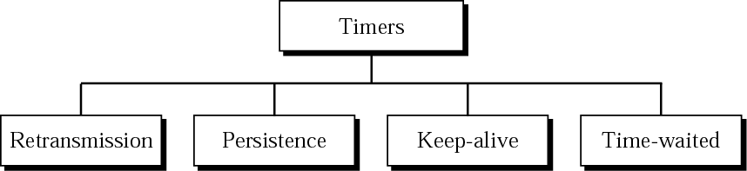
Figure 22.27 TCP timers
TCP seg.
ACK
Exponential averaging 기법
Retransmission time = 2 x RTT (round-trip-time)
RTT = a (previous RTT) + (1-a)(current RTT)
RTT
a = 0.7
20 ms
20 ms
26 ms
21.8 ms (20*0.7 + 26*0.3 = 14 + 7.8)
22 ms
21.86 ms (21.8*0.7 + 22*0.3 = 15.26 + 6.6)

